Slide 1
Multi-Layered Feedforward Neural Networks
Architecture
Multi-layered Feedforward NN
Activation functions
Sigmoid function
Learning algorithms
Backpropagation algorithm

Slide 2
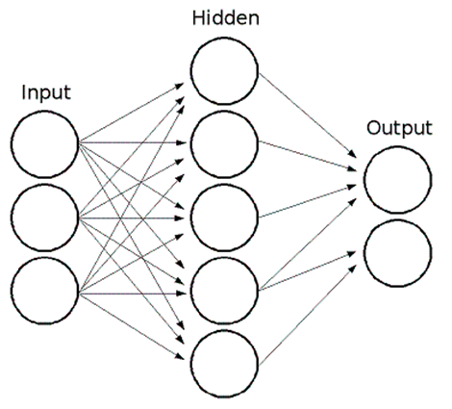
Architecture of Multi-Layered Feedforward Neural Networks
Input layer
Input data is fed into this layer.
Hidden layer
Intermediate layer between input layer and output layer
not directly observable from input and output
Output layer
Generates actual output for the given data
input
data
actual
output
target
output
data

Slide 3
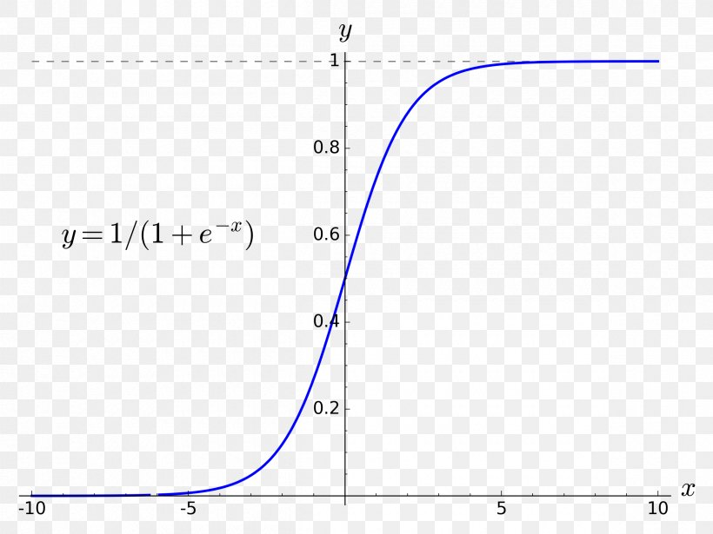
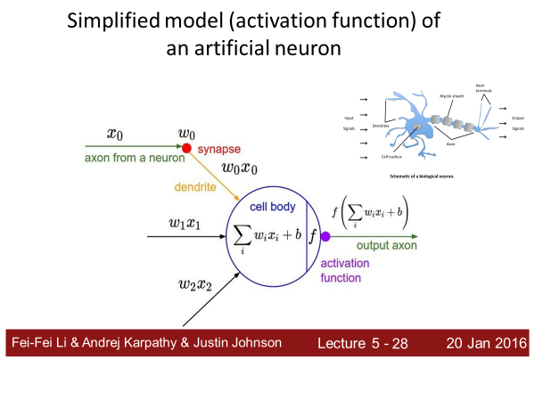
Activation Function of Multi-Layered Feedforward Neural Networks
Sigmoid function
example, Logistic function as the left figure
takes a real value as input and produces output value between 0 and 1
This type of activation function applies to Hidden units and Output units. (not Input units)

Slide 4
Learning Algorithm: Backpropagation Algorithm
Backpropagation algorithm is one of the most fundamental contribution in a neural network machine learning.
Paul Werbos(1974, 1982), Hinton, Rumelhart, Williams(1986),
Learning representations by back-propagating errors (Nature Volume 323, pp 533-536, 1986).
“The procedure repeatedly adjusts the weights of the connections in the network so as to minimize a measure of the difference between the actual output vector of the net and the desired output vector.” -Hinton

Slide 5
Backpropagation Algorithms
First step is the propagation of input signals forward through the network.
Second step is the adjustment of weights based on error signals backward through the network.

Slide 6
First step: Backpropagation Algorithms
When an input comes into the input layer, the input value propagates to the output layer through the hidden layer.
With the input, weights, and activation functions, this step generates outputs of hidden units and output units.
This actual output value is compared with the desired target output value.
If the desired target output and the actual output of the neural network have different results, the connection weights are changed in the second step.
input
data
actual
output
target
output
data
actual
output

Slide 7
Backpropagation Algorithm Procedure
First Step
1. Initialization of the connection weights as small random numbers.
2. Feeding the input to the input units: Input_{p}=(I_{p1}, I_{p2}, …, I_{pi}), where Input_{p} is the pth training example.
3. Computation of the net values (weighted sum) of the hidden units is the weight from the input unit i to the hidden unit j.
4. Computation of the output values of the hidden units is the output function of the hidden unit j.
5. Computation of the net values (weighted sum) of the output units is the weight from the hidden unit j to the output unit k.
6. Computation of the output values of the output units is the output function of the output unit k.

Slide 8
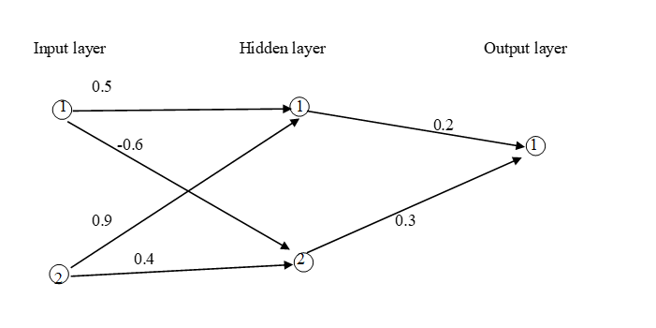

Example of First Step
The Training data
The value 1 is injected into input unit1
The value 1 is injected into input unit2.
The target output in output unit1 is 0.
The initial weights are given as right.
The transfer function is a sigmoid function.
Learning coefficient is 0.7.
<Hidden Units>
The net of hidden unit 1: 1 * 0.5 + 1 * 0.9 = 1.4
The net of hidden unit 2: 1 * (-0.6) + 1 * 0.4 = -0.2
The output of hidden unit 1: 1 / 1 + e^{-(1.4)} = 0.802
The output of hidden unit 2: 1 / 1 + e^{-(-0.2)} = 0.450
<Output Unit>
The net of output unit 1: 0.802*0.2 + 0.450*0.3= 0.2954
The output of output unit 1: 1 / 1 + e^{-(0.2954)} = 0.5733
With input data (1, 1), this network generates actual output 0.5733.
How is this output? What is the given target output for the input data (1,1)?
1
0
1

